Slide 1
Signal Processing
Dr. Michael Nasief

Slide 2
Complex Waveforms

Slide 3
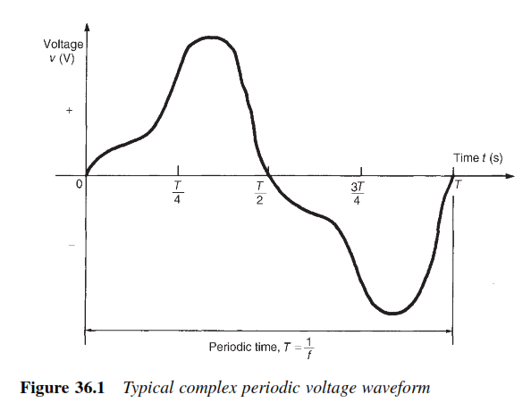

Slide 4
The general equation for a complex waveform

Slide 5
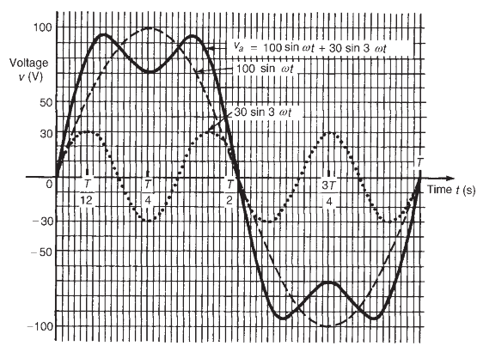
Harmonic synthesis

Slide 6
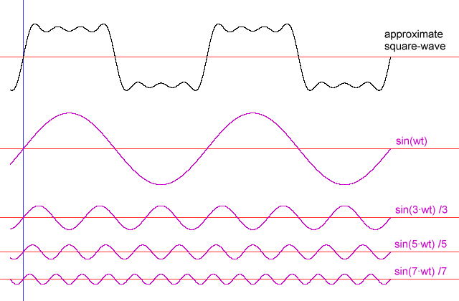
Fourier Series

Slide 7
Trigonometric Form
How to evaluate the Fourier Series Coefficients (FSC) of x(t)?
To find a₀ integrate both side of the equation over a full period

Slide 8
Trigonometric Form

Slide 9
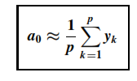
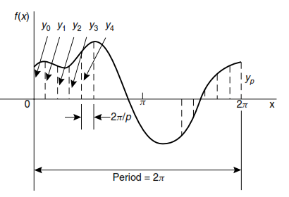
Harmonic analysis on data given in tabular or graphical form

Slide 10
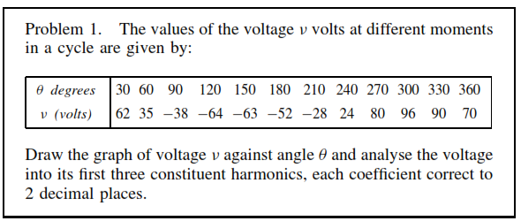
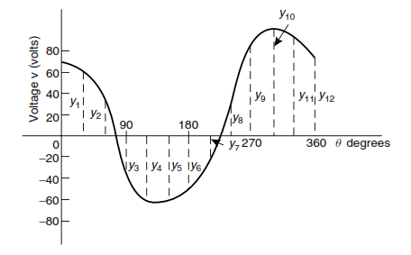

Slide 11
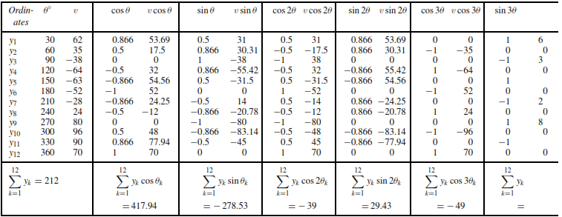

Slide 12
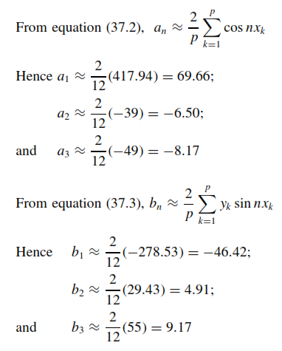

Slide 14
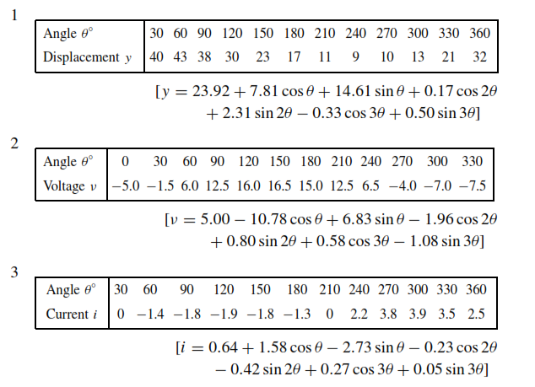
(Problems (Self Test

